Slide 1
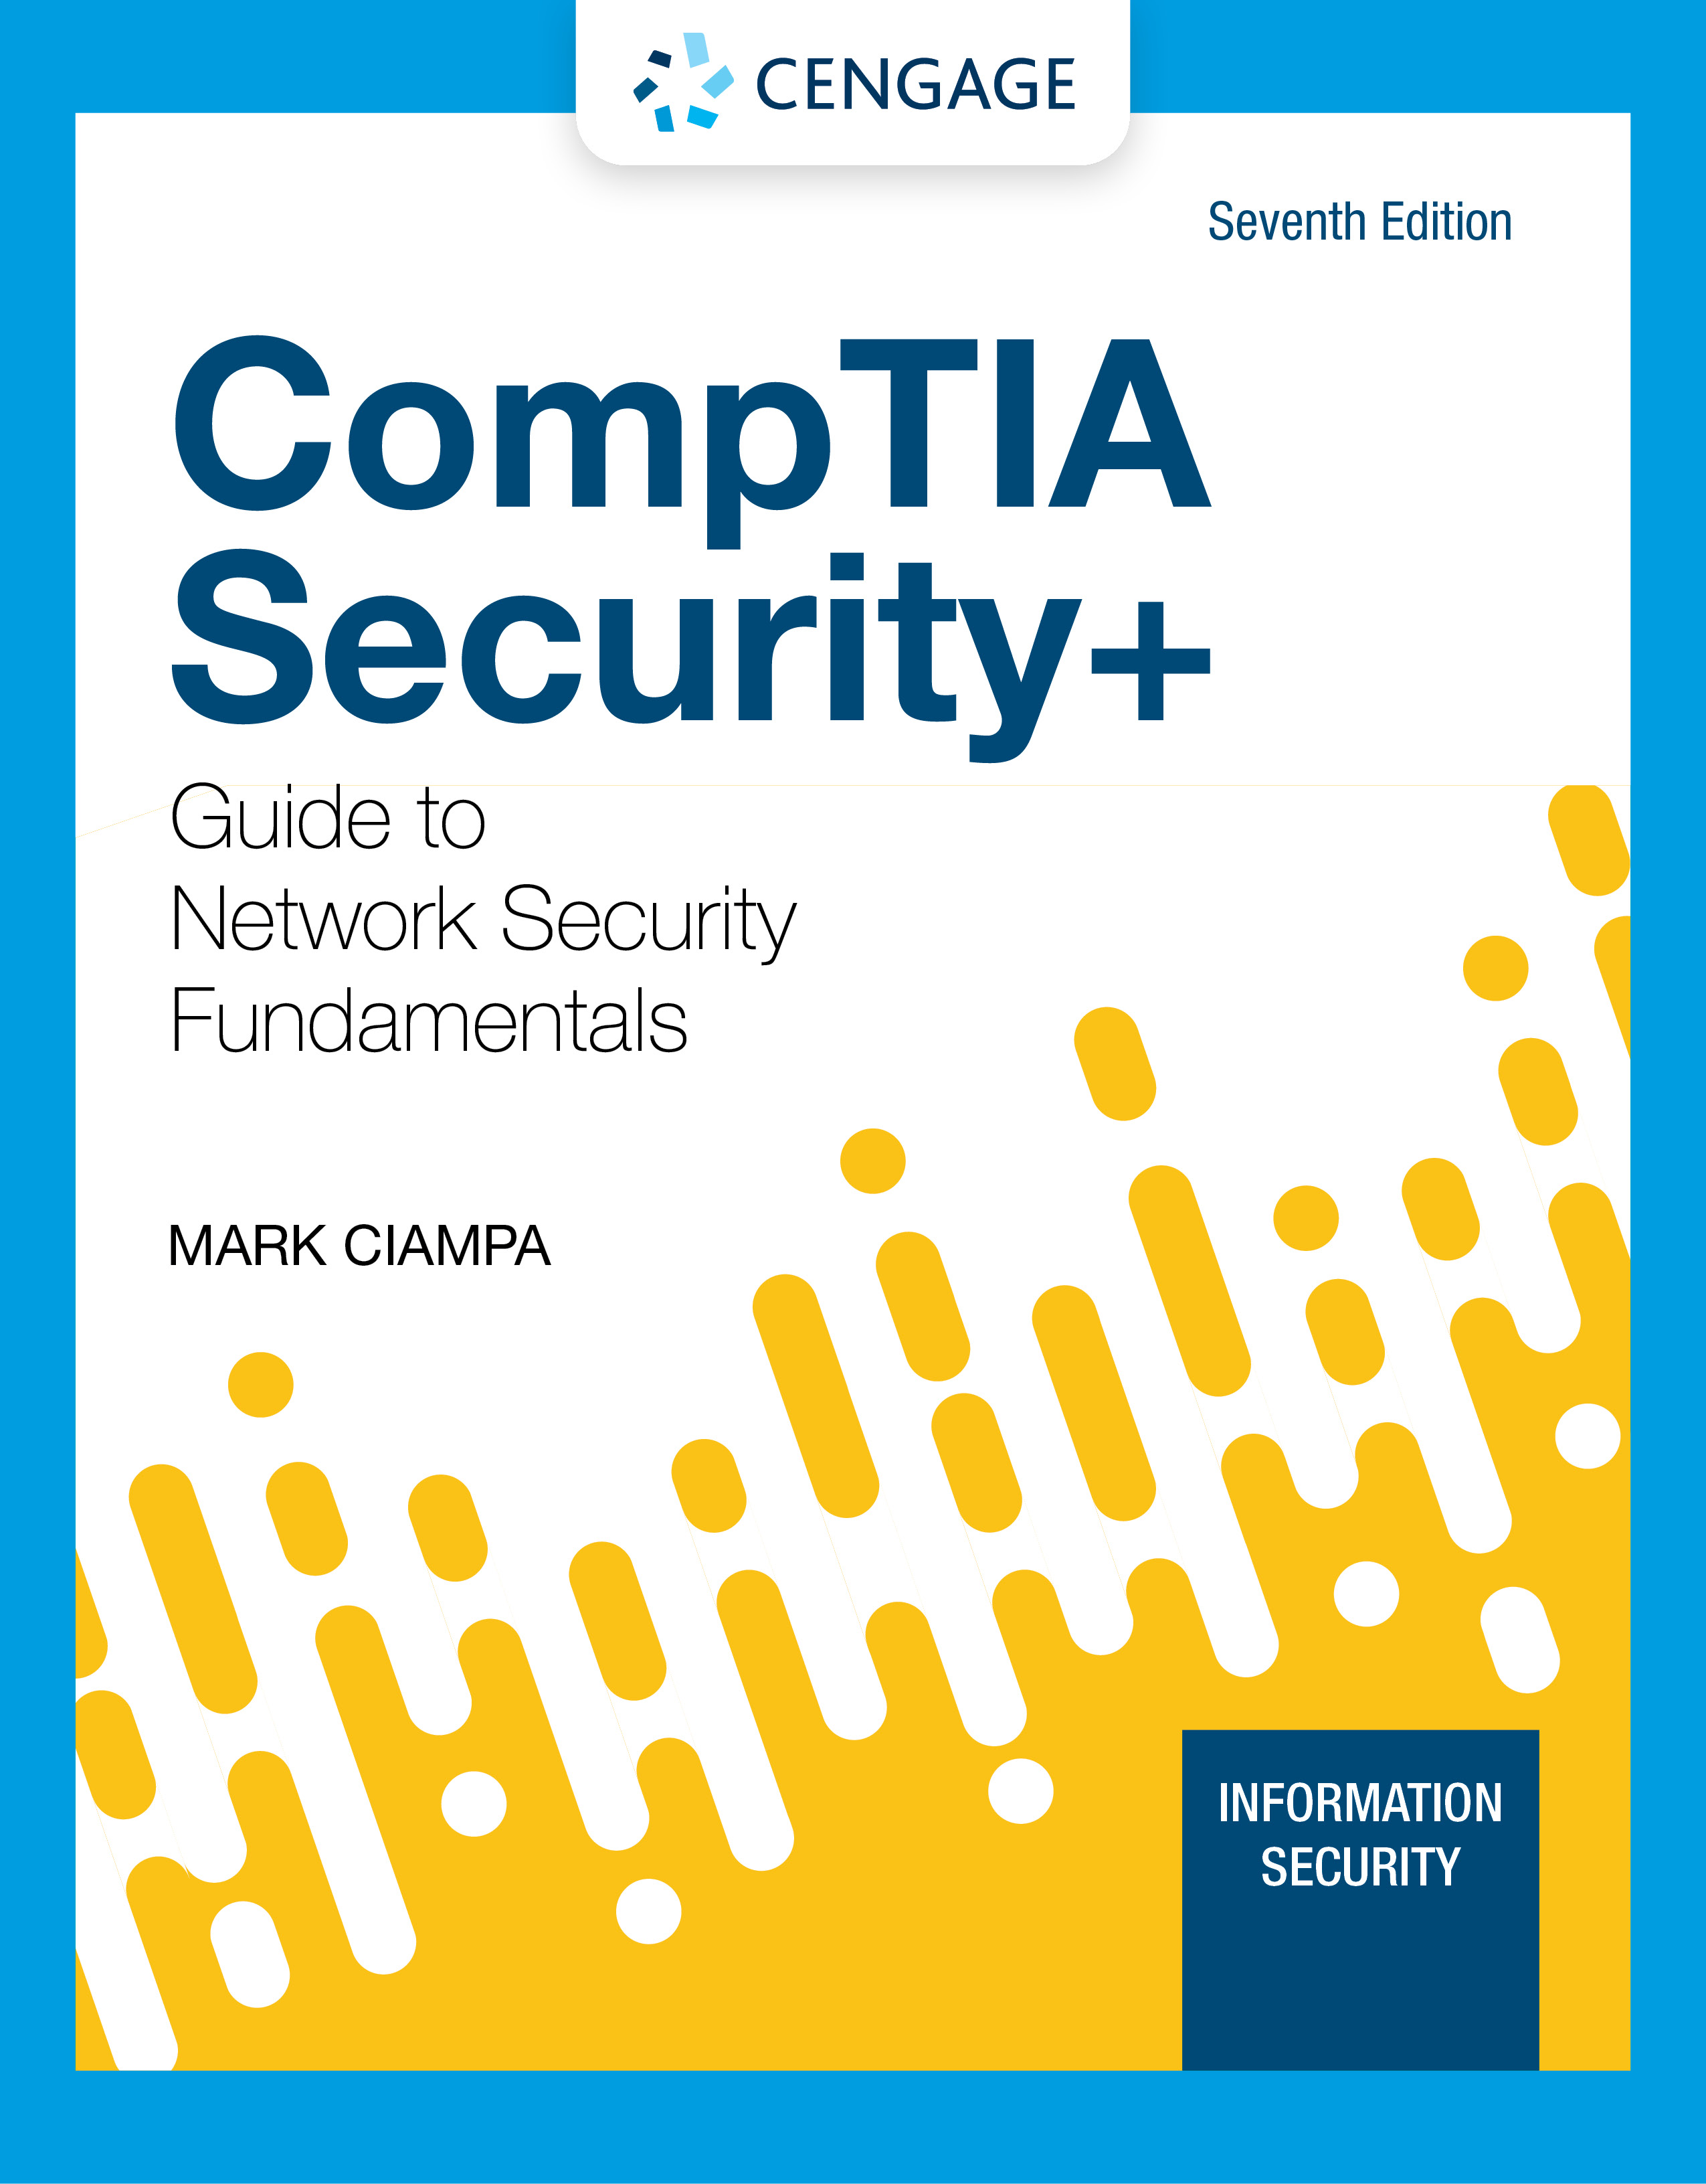
Module 12: Authentication
CompTIA Security+ Guide
to Network Security Fundamentals, 7th Edition

Slide 2
Module Objectives
By the end of this module, you should be able to:
1. Describe the different types of authentication credentials
2. Explain the different attacks on authentication
3. Describe how to implement authentication security solutions

Slide 3
Types of Authentication Credentials
Element | Description | Scenario example
Somewhere you are | Restricted location | Restricted military base
Something you are | Unique biological characteristic that cannot be changed | Fingerprint reader to enter building
Something you have | Possession of an item that nobody else has | Riker’s RFID card
Someone you know | Validated by another person | Li knows Peyton
Something you exhibit | Genetically determined characteristic | Peyton’s flaming red hair
Something you can do | Perform an activity that cannot be exactly copied | Paolo’s signature
Something you know | Knowledge that nobody else possesses | Combination to unlock locker

Slide 4
Something You Know: Passwords (1 of 9)
Passwords are the most common type of IT authentication today
Passwords provide only weak protection and are constantly under attack
Password Weaknesses
Weakness of passwords is linked to human memory
Humans can memorize only a limited number of items
Long, complex passwords are most effective
But they are the most difficult to memorize
Users must remember passwords for many different accounts
Each account password should be unique
Many security policies mandate that passwords must expire
Users must repeatedly memorize passwords

Slide 5
Something You Know: Passwords (2 of 9)
Password Weaknesses (continued)
Users often take shortcuts and use a weak password
Examples: common words, short password, a predictable sequence of characters or personal information
When attempting to create stronger passwords, they generally follow predictable patterns:
Appending: using letters, numbers, and punctuation in a pattern
Replacing: users use replacements in predictable patterns

Slide 6
Something You Know: Passwords (3 of 9)
Attacks on Passwords
When users create passwords, a one-way hash algorithm creates a message digest (or hash) of the password
Attackers work to steal the file of password digests
They can then use a stolen has to impersonate the user
They can also load that file onto their own computers and then use a sophisticated password cracker, which is software designed to break passwords
Password crackers create known digests called candidates
The different means of creating candidates include:
Brute force, rule, dictionary, rainbow tables, and password collections

Slide 7
Something You Know: Passwords (4 of 9)
Password Spraying
A password spraying attack selects one or a few common passwords and then enters the same password when trying to login to several user accounts
Brute Force Attack
In an automated brute force attack, every possible combination of letters, numbers, and characters used to create encrypted passwords are matched against the stolen hash file
In an online brute force attack, the same account is continuously attacked (called pounded) by entering different passwords
An offline brute force attacks uses the stolen hash file
This is the slowest yet most thorough method

Slide 8
Something You Know: Passwords (5 of 9)
Rule Attack
A rule attack conducts a statistical analysis on the stolen passwords that is used to create a mask to break the largest number of passwords
There are three basic steps in a rule attacks:
1. A small sample of the stolen password plaintext file is obtained
2. Statistical analysis is performed on the sample to determine the length and character sets of the passwords
3. A series of masks is generated that will be most successful in cracking the highest percentage of passwords

Slide 9
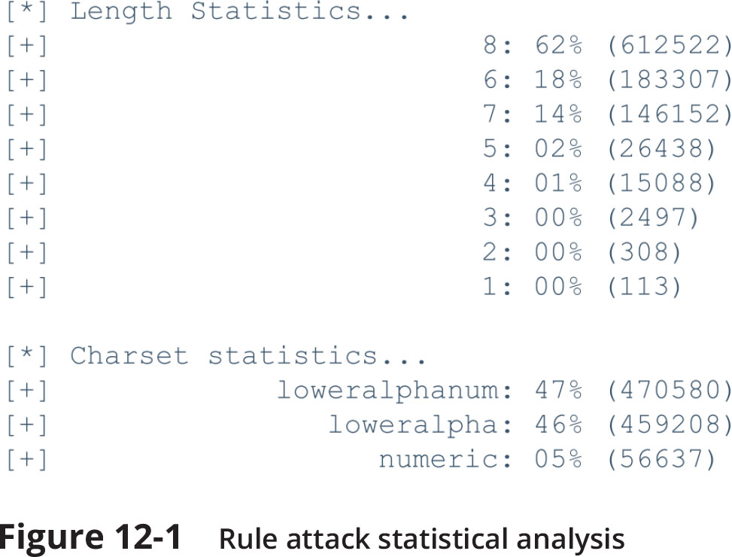
Something You Know: Passwords (6 of 9)

Slide 10
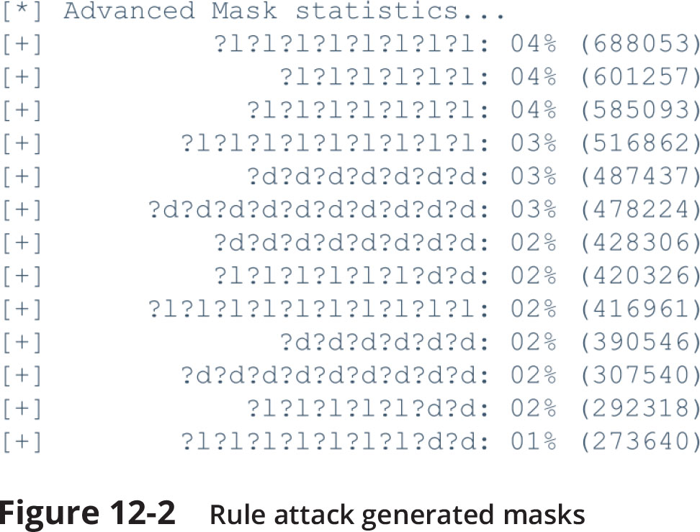
Something You Know: Passwords (7 of 9)

Slide 11
Something You Know: Passwords (8 of 9)
Dictionary Attack
In a dictionary attack, the attacker creates digests of common dictionary words and compares against a stolen digest file
Pre-image attack is a dictionary attack that uses a set of dictionary words and compares it with the stolen digests
Birthday attack is the search for any two digests that are the same
Rainbow Tables
Rainbow tables create a large pregenerated data set of candidate digests
Rainbow table advantages over other attack methods
Can be used repeatedly
Faster than dictionary attacks
Less memory on the attacking machine is required

Slide 12
Something You Know: Passwords (9 of 9)
Password Collections
In 2009, an attacker used an SQL injection attack and more than 32 million user passwords (in cleartext) were stolen
These passwords gave attackers a large corpus of real-world passwords
Using stolen password collections as candidate passwords is the foundation of password cracking today
Almost all password cracking software tools accept these stolen “wordlists” as input

Slide 13
Something You Have: Smartphone and Security Keys (1 of 5)
Multifactor authentication (MFA) is a type of authentication where a user is using more than one type of authentication credential
Example: what a user knows and what a user has could be used together for authentication
Single-factor authentication occurs when a user is using just one type of authentication
Using two types is called two-factor authentication (2FA)
Most common items used for authentication are specialized devices, smartphones, and security keys

Slide 14
Something You Have: Smartphone and Security Keys (2 of 5)
Specialized Devices
A smart card holds information to be used as part of the authentication process
A common access card (CAC) that is issued by US Department of Defense
In addition to integrated chip, it has a bar code, magnetic strip, and the bearer’s picture
There are several disadvantages to smart cards such as the following:
Each device that uses smart card authentication must have a specialized hardware reader and device driver software installed
Smart cards that have a magnetic strip are subject to unauthorized duplication called card cloning
Stealing the information is often done by a process called skimming

Slide 15
Something You Have: Smartphone and Security Keys (3 of 5)
Specialized Devices (continued)
Windowed tokens create a one-time password (OTP) which is an authentication code that can be used only once or for a limited period of time
There are two types of OTPs
Time-based one-time password (TOTP)
Synched with an authentication server where the code is generated from an algorithm
The code changes every 30 to 60 seconds
HMAC-based one-time password (HOTP) is “event-driven” and changes when a specific event occurs

Slide 16
Something You Have: Smartphone and Security Keys (4 of 5)
Smartphones
Once users enter their username and password, their smartphone is then used for the second authentication factor using one of the following methods:
A phone call
SMS text message
Authentication app
Using a smartphone for authentication is not considered secure
An OTP received through an SMS text message can be “phished”
A malware infection on the phone can target the authentication app

Slide 17
Something You Have: Smartphone and Security Keys (5 of 5)
Security Keys
A security key is a dongle that is inserted into the USB port or Lightning port or held near the endpoint
A feature of security keys is attestation
Attestation is a key pair that is “burned” into the security key during manufacturing and is specific to a device model
Attestation keys have associated attestation certificates and those certificates chain to a root certificate that the service trusts
Some security key systems require that users must initially enroll two security keys in the event that one is lost or destroyed

Slide 18
Something You Are: Biometrics (1 of 6)
Physiological Biometrics
Physiological biometrics uses a person’s unique physical characteristics for authentication
Several unique characteristics of a person’s body can used to authenticate
Specialized Biometric Scanners
Retinal scanner uses the human retina as a biometric identifier
It maps the unique patterns of a retina by directing a beam of low-energy infrared light (IR) into a person’s eye
There are two basic types of fingerprint scanners:
Static fingerprint scanner takes a picture and compares with image on file
Dynamic fingerprint scanner uses a small slit or opening

Slide 19
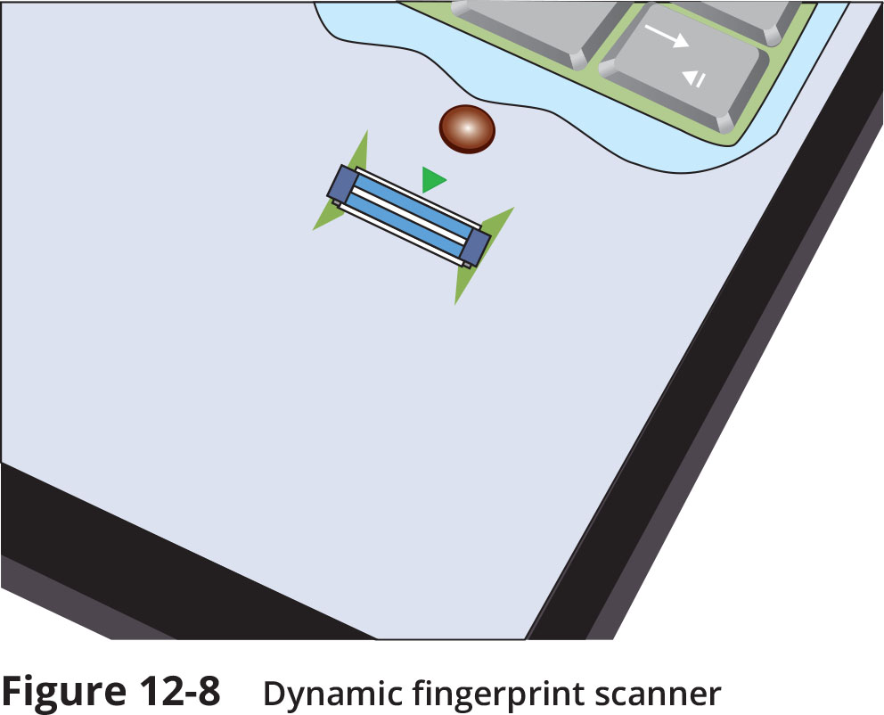
Something You Are: Biometrics (2 of 6)
Figure 12-8 Dynamic fingerprint scanner

Slide 20
Something You Are: Biometrics (3 of 6)
Other human characteristics that can be used for authentication include:
A person’s vein can be identified through a vein-scanning tablet
A person’s gait or manner of walking
Standard Input Devices
Voice recognition uses a standard computer microphone to identify users based on the unique characteristics of a person’s voice
An iris scanner uses a standard webcam to identify the unique characteristics of the iris
Facial recognition uses landmarks called nodal points on human faces for authentication

Slide 21
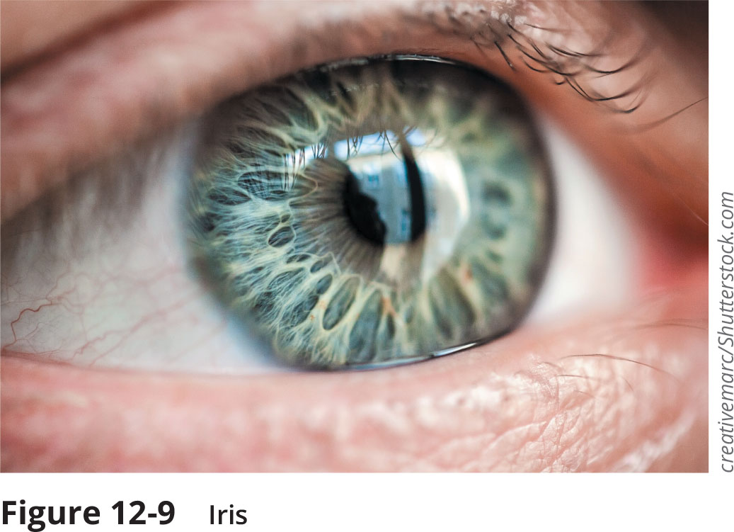
Something You Are: Biometrics (4 of 6)
Figure 12-9 Iris

Slide 22
Something You Are: Biometrics (5 of 6)
Biometric Disadvantages
Cost of specialized hardware scanning devices
Readers have some amount of error
The false acceptance rate (FAR) is the frequency at which imposters are accepted as genuine
The false rejection rate (FRR) is the frequency that legitimate users are rejected
Biometric systems can be “tricked”
A concern with biometrics is the efficacy rate
Efficacy may be defined as the benefit achieved
Critics question the sacrifice of user privacy

Slide 23
Something You Are: Biometrics (6 of 6)
Cognitive Biometrics
Cognitive biometrics relates to perception, thought process, and understanding of the user
It is considered easier for the user to remember because it is based on user’s life experiences
Cognitive biometrics is also called knowledge-based authentication
Picture Password was introduced by Microsoft for Windows 10 touch-enabled devices
Users select a picture to use for which there should be at least 10 “points of interest” that could serve as “landmarks” or places to touch

Slide 24
Something You Do: Behavioral Biometrics
Behavioral biometrics
Behavioral biometrics authenticates by normal actions the user performs
A type of behavioral biometrics is keystroke dynamics
Attempts to recognize user’s typing rhythm
Keystroke dynamics uses two unique typing variables
Dwell time, which is the time it takes to press and release a key
Flight time is the time between keystrokes
Keystroke dynamics holds a great amount of potential because it requires no specialized hardware

Slide 25
Knowledge Check Activity 1
What process can be done on smart cards that steals the information contained on them?
a. Skimming
b. Injection
c. Spraying
d. Cracking

Slide 26
Knowledge Check Activity 1: Answer
What process can be done on smart cards that steals the information contained in them?
Answer: a. Skimming
Skimming is a process in which a threat actor attaches a small device that fits inside a card reader that reads the card when it is inserted and removed from the reader.

Slide 27
Authentication Solutions
Several solutions for securing authentication include the following:
Security surrounding passwords
Secure authentication technologies

Slide 28
Password Security (1 of 4)
Protecting Password Digests
One method is to use salts, which consists of a random string that is used in hash algorithms
Passwords can be protected by adding a random strong to the user’s cleartext password before it is hashed
Salts make dictionary attacks and brute force attacks much slower and limit the impact of rainbow tables
Another method is to use key stretching
Key stretching is a specialized password hash algorithm that is intentionally designed to be slower
Two key stretching algorithms: brypt and PBKDF2

Slide 29
Password Security (2 of 4)
Managing Passwords
The most critical factor in a strong password is length
The longer a password is, the more attempts an attacker must make to break it
Due to the limitations of human memory, security experts universally recommend using technology to store and manage passwords
Technology used for securing passwords includes using the following:
Password vaults
Password keys
Hardware modules

Slide 30
Password Security (3 of 4)
Managing Passwords (continued)
A password vault is a secure repository where users can store passwords (also known as a password manager)
Three basic types of password vaults:
Password generators
Online vaults
Password management applications
Password keys are a secure hardware-based solution to store passwords
A hardware security module (HSM) is a removable external cryptographic device that includes an onboard random number generator and key storage facility
An HSM can also perform encryption and can back up sensitive material in an encrypted form

Slide 31
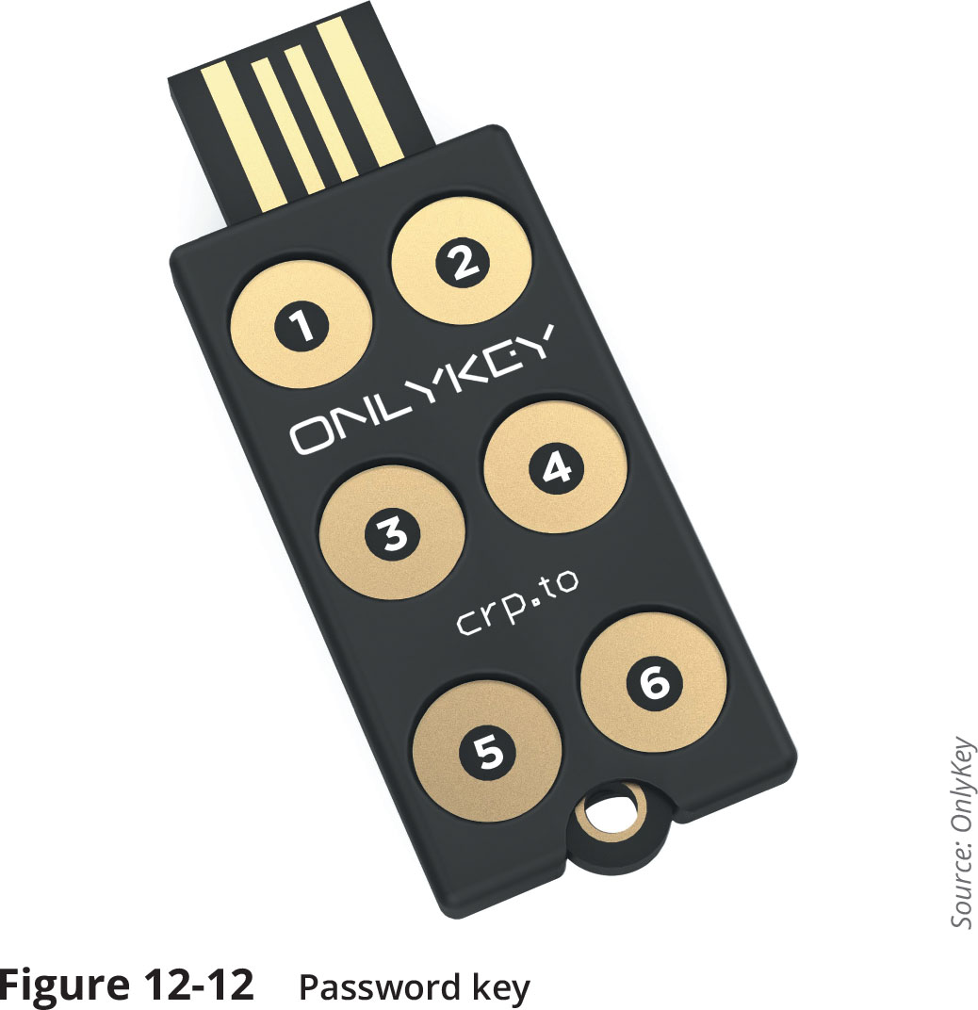
Password Security (4 of 4)
Figure 12-12 Password key

Slide 32
Secure Authentication Technologies (1 of 8)
Single Sign-On
Identity management is using a single authentication credential shared across multiple networks
It is called federation (sometimes called federated identity management or FIM) when networks are owned by different organizations
Single sign-on (SSO) uses one authentication credential to access multiple accounts or applications

Slide 33
Secure Authentication Technologies (2 of 8)
Authentication Services
Different services can be used to provide authentication
RADIUS or Remote Authentication Dial In User Service was developed in 1992 and became an industry standard
RADIUS was originally designed for remote dial-in access to a corporate network
RADIUS client is typically a device such as a wireless AP that is responsible for sending user credentials and connection parameters to the RADIUS server
RADIUS user profiles are stored in a central database that all remote servers can share
Advantages of a central service include the following:
Increases security due to a single administered network point
Easier to track usage for billing and keeping network statistics

Slide 34
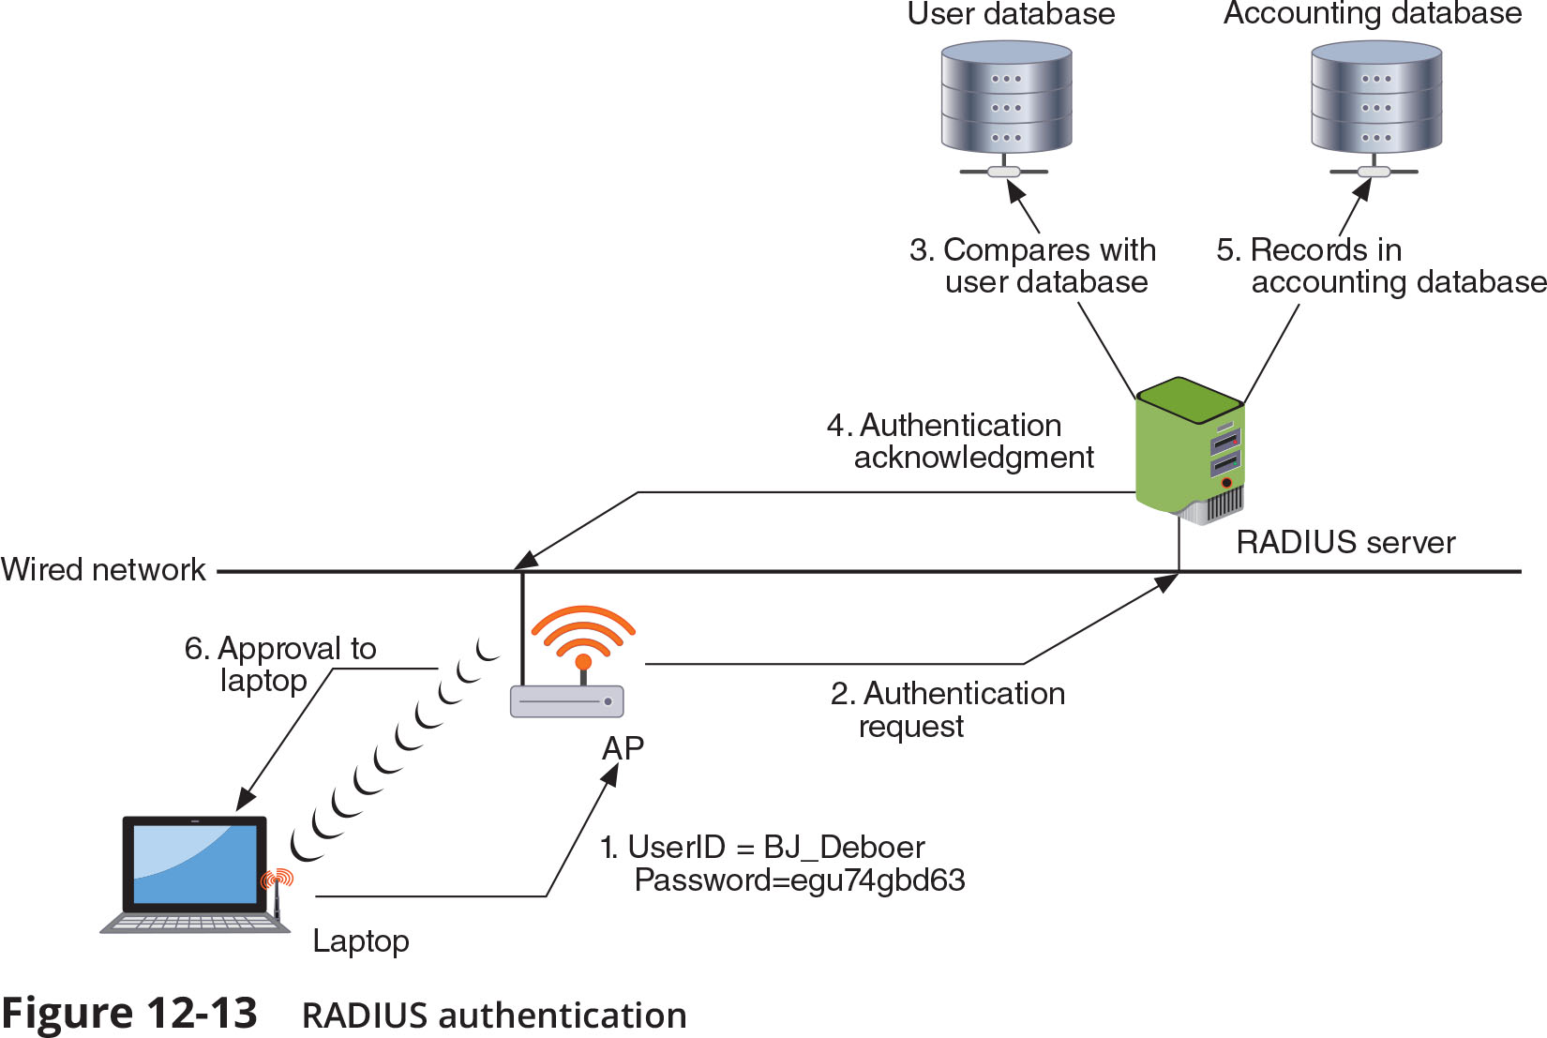
Secure Authentication Technologies (3 of 8)

Slide 35
Secure Authentication Technologies (4 of 8)
Kerberos is an authentication system developed at MIT
It uses encryption and authentication for security
Works like using a driver’s license to cash a check
Kerberos ticket characteristics:
Difficult to copy
Contains information linking it to the user
It lists restrictions
Expires at some future date
Kerberos is typically used when a user attempts to access a network service and that service requires authentication

Slide 36
Secure Authentication Technologies (5 of 8)
Terminal Access Control Access Control System + (TACACS+)
TACACS is an authentication service similar to RADIUS
It is commonly used on UNIX devices that communicates by forwarding user authentication information to a centralized server
The current version is TACACS+

Slide 37
Secure Authentication Technologies (6 of 8)
Directory Service
A directory service is a database stored on the network that contains information about users and network devices
Directory services make it easier to grant privileges or permissions to network users and provide authentication
SAML
Security Assertion Markup Language (SAML) is an XML standard that allows secure web domains to exchange user authentication and authorization data
SAML allows a user’s login credentials to be stored with a single identity provider instead of being stored on each web service provider’s server
SAML is used extensively for online e-commerce business-to-business (B2B) and business-to-customer (B2C) transactions

Slide 38
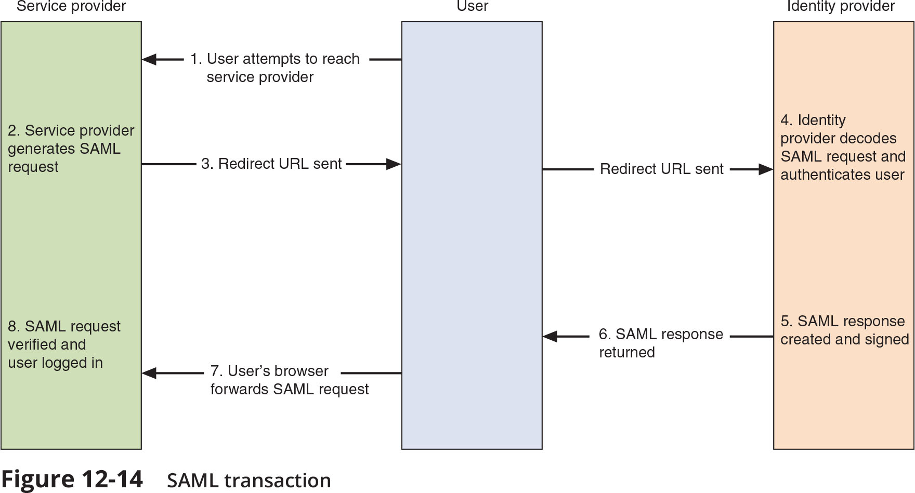
Secure Authentication Technologies (7 of 8)

Slide 39
Secure Authentication Technologies (8 of 8)
Authentication Framework Protocols
A framework for transporting authentication protocols is known as the Extensible Authentication Protocol (EAP)
EAP was created as a more secure alternative to Challenge-Handshake Authentication Protocol (CHAP), the Microsoft version of CHAP (MS-CHAP), and Password Authentication Protocol (PAP)
EAP is a framework for transporting authentication protocols instead of the authentication protocol itself
EAP defines the format of the messages and uses four types of packets:
Request, response, success, and failure

Slide 40
Knowledge Check Activity 2
Which standard allows secure web domains to exchange user authentication and authorization data?
a. LDAP
b. SAML
c. MS-CHAP
d. TACACS

Slide 41
Knowledge Check Activity 2: Answer
Which standard allows secure web domains to exchange user authentication and authorization data?
Answer: b. SAML
Security Assertion Markup Language (SAML) is an XML standard that allows secure web domains to exchange user authentication and authorization data.

Slide 42
Self-Assessment
One of the ways to help remember technical information is to relate where and how a technology is implemented. If possible, ask an IT professional at your school or your place of work which of the authentication technologies are being used in the school’s or workplace’s network. As the person why that particular technology was chosen and relate the information you learned back to the contents of this module.

Slide 43
Summary (1 of 2)
Authentication credentials can be classified into five categories: what you know, what you have, what you are, what you do, and where you are
Passwords provide a weak degree of protection because they rely on human memory
Most password attacks today use offline attacks where attackers steal encrypted password file
A dictionary attack begins with the attacker creating digests of common dictionary words, which are compared with those in a stolen password file
Another type of authentication credential is based on the approved user having a specific item in her possession
A hardware token is a small device that generates a code from an algorithm once every 30 to 60 seconds

Slide 44
Summary (2 of 2)
Biometrics bases authentication on characteristics of an individual
Standard and cognitive biometrics are examples
Behavioral biometrics authenticates by normal actions the user performs
One way for an enterprise to protect stored digests is to add a salt, which consists of a random string that is used in hash algorithms
Single sign-on (SSO) allows a single username and password to gain access to all accounts
Different services can be used to provide authentication

